Slide 1
Predicting Car Accident Severity in Seattle

Slide 2
Intrest
Such Machine Learning models will be useful for many companies.
1. These models can be used by city planning officials to plan road markers, traffic light lengths, traffic patterns and routing etc.,
2. Digital map providing companies and traffic advising companies like Google Maps, Waze etc., can utilize the prediction to warn their customers of perfect storm conditions of an accident when they are driving in those areas.
3. Vehicle Insurance companies can use these models to evaluate claims for vehicle accidents.

Slide 3
Data acquisition and cleaning
A more raw data can from Seattle GeoData (DOT, 2018) where most of the data and attributes can be studied
The imported data has 194673 observations of various attributes such as severity code, severity code description, Address type, Junction type, collision type,etc., The attribute Types and descriptions can be found at Seattle DOT
Data downloaded from data source with nulls and Nan values were replaced with Unknown/Other values.
Data formats were converted to other formats as required. A few columns such as Severity Code, Description & SDOT Code, Description & ST Code and Description were combined to new columns for analysis purposes.

Slide 4
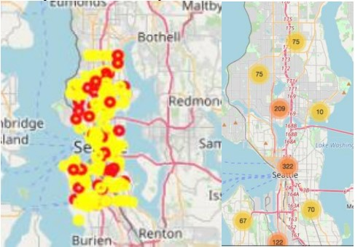
Car Accident Severity in Seattle using folium
(1000 samples were plotted

Slide 5
Model Creation
Supervised classification models run well with the classification datasets. Hence, the following models will be created, fitted with training data and predicted with test data and evaluation datasets.
1. Knn
2. DecisionTree
3. SVM
4. Logistic Regression
5. Random Forest (Once to compare with decision tree)

Slide 6
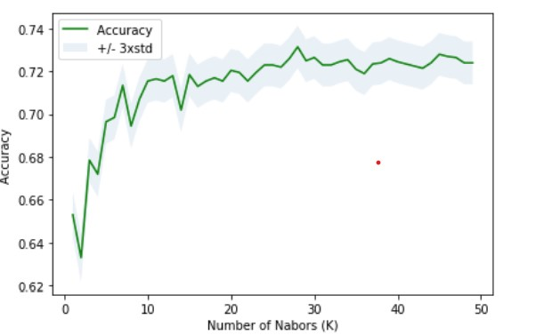
Results
All the models were built, fitted, predicted and evaluated as follows: Knn: Knn was run for 50 iterations with k varying from 1 to 50.The best performance was on k=28 for the 4th feature set.

